Slide 1
Modular epidemiological hospital efficiency simulator
Group: Amin Danas Edgaras Ella Mateusz
Tutor: Andrius Kuprys
Notes:
Intro - briefly and officially

Slide 2
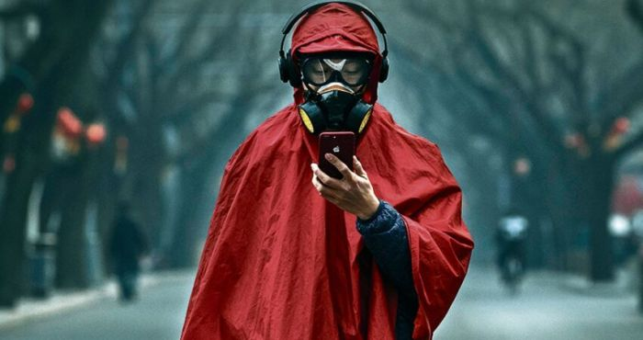
Notes:
Intro - topic justification. Appeal to common experience and importance

Slide 3
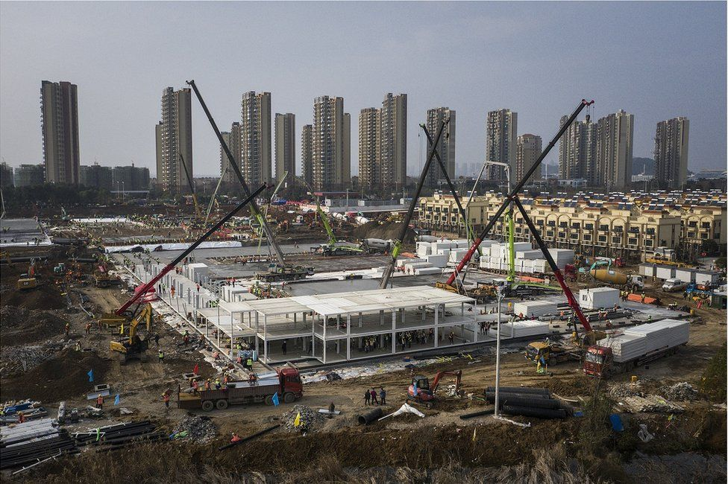
Notes:
Move towards particularity, describe iteration 1

Slide 4
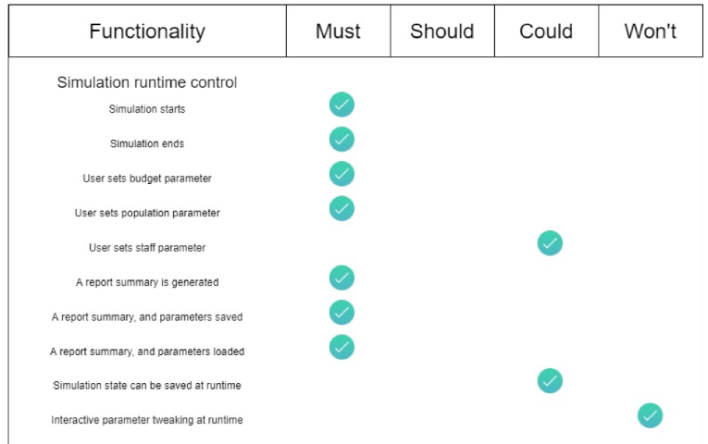

Slide 5
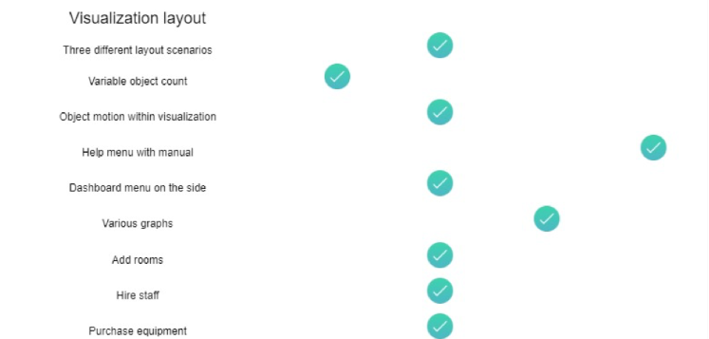

Slide 6
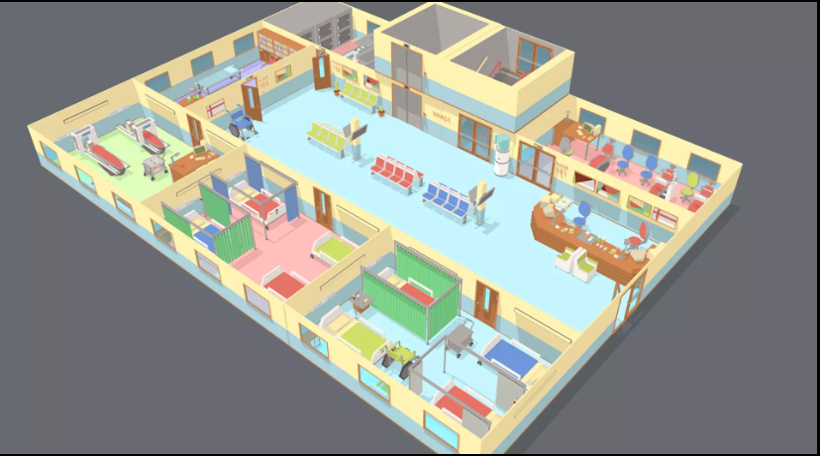
Notes:
Initial ambitious plan (loss of teammate)

Slide 7
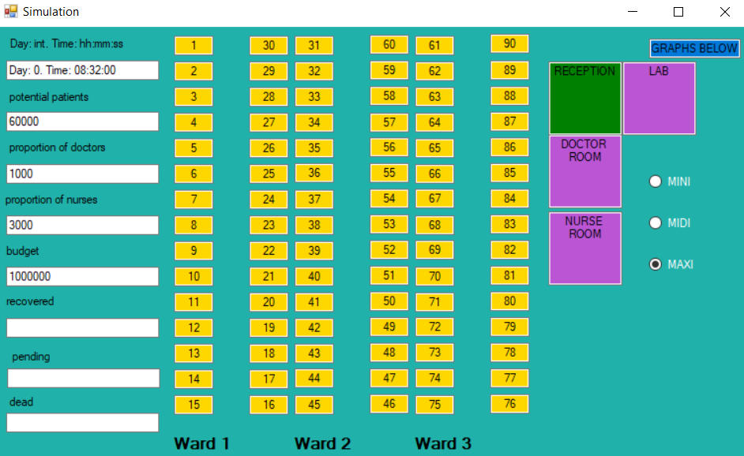
Notes:
Simplified version, that got dismissed

Slide 8
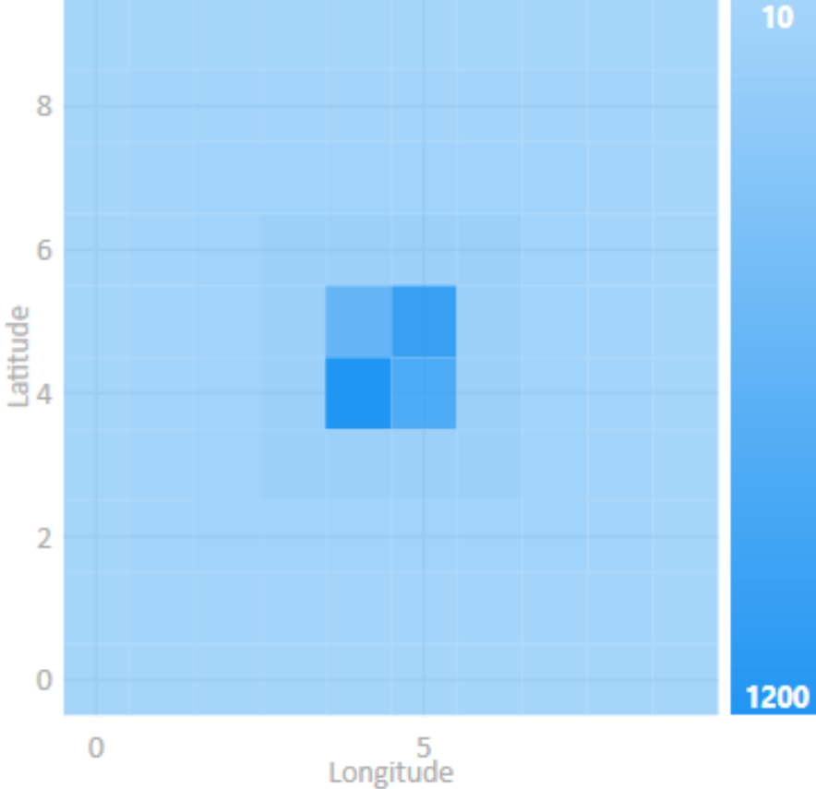
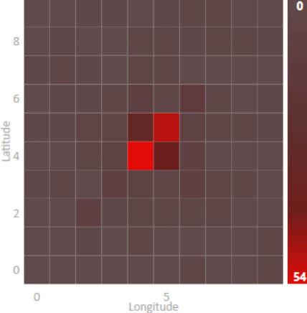
Notes:
Finally clarity in accepting this format

Slide 9
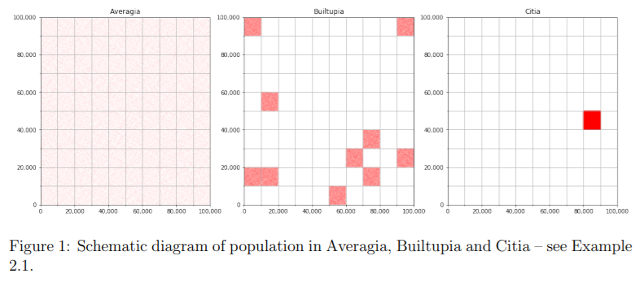
Notes:
Reference, that it is being done by other academics. Dave Babbitt, D. , Garland, P., Johnson, O. (2020) - UK

Slide 10
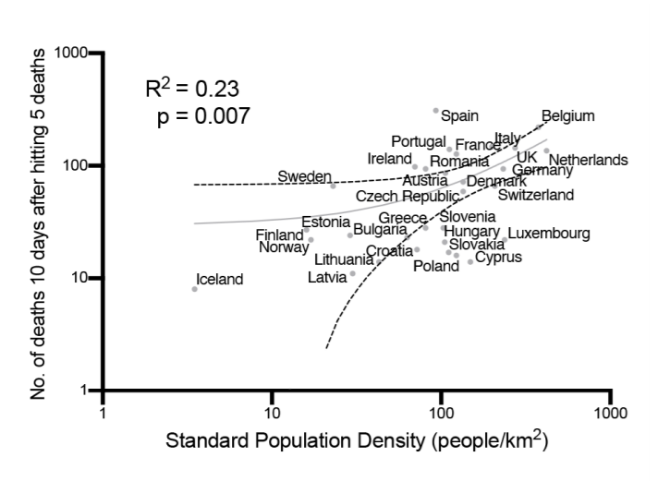
Notes:
Curves, from that very same article.

Slide 11
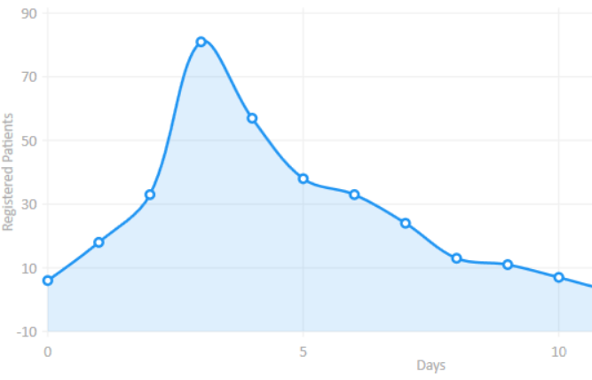
Notes:
Of course we have curves too. Just as flatten the curve narrative was popularized. We got this requirement literally from TV.

Slide 12
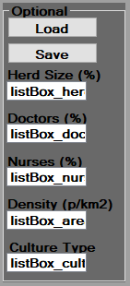
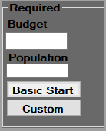
Static Variability
Notes:
These are the variables that are required and optional for starting the simulation, as you can see the budget for the hospital and population is required, and having enough budget for the hospital is essential to finish the simulation with a success. Optionally you can choose herd size percentage that will define how much population will have to get through the virus, before the virus will slow down the spread, because it will not have many other people to infect. Doctor and Nurses percentage is about how much you are willing to spend your budget on the employees of the Hospital. Density is a number of people per district. Culture Type defines how fast virus can spread. You can only define these variables before starting the start. Custom button can be used to user’s defined areas for population and/or budget. I will talk about Load and Save functionalities and in a few minutes as well.

Slide 13

Dynamic Variability
Notes:
Every simulation starts with no policy. Dynamic variabilities can be changed in the runtime. Herd Immunity is a policy that was applied in the UK and it was a main policy in the Sweden as you may know. User can apply these policies to “flatten the curve”, it applies stricter rules within the area that we are simulating the Hospital on, which results in smaller spread rate. It’s important to know that once User selects Stricter Policy, and later changes to lighter policy, for example No Policy, the spread rate will increase once again.

Slide 14
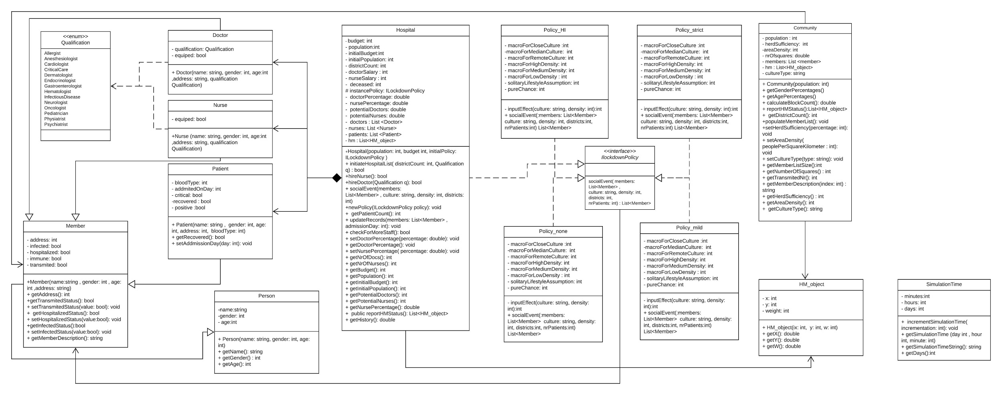
Complete UML diagram
Notes:
This is our object-oriented UML class diagram. We are aware that is looks complicated, but I would like to briefly describe the main elements, that is Hospital, and Community. The Hospital consists of the main variables and methods that are essential for the simulation to work. The community class works with the Member class, that allows us to form a of a “group” for each simulated person, but it also handles area density, and heat map objects. We have used Strategy design pattern for the Policies. On the left side of the UML diagram we have Doctor, Nurse, and Patient that inherits from a class called Member, which inherits from class Person.

Slide 15
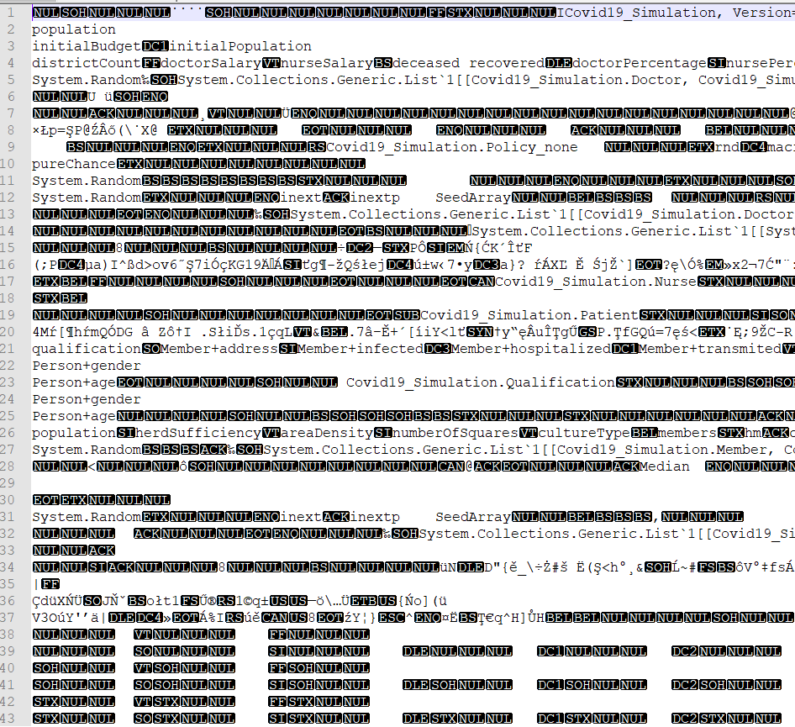
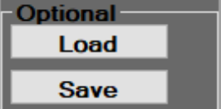
Saving / Loading
Notes:
You can save and load parameters, this feature is serializing the required objects. And while loading, it is deserializing them.

Slide 16
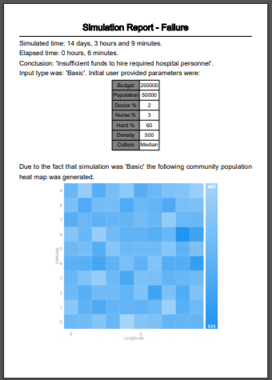
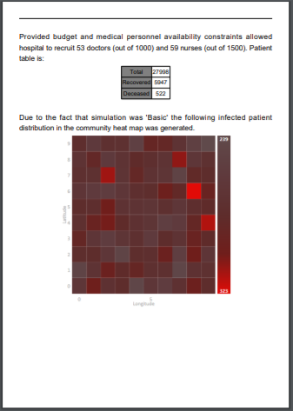
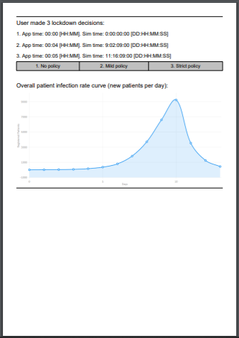
Report generation
Notes:
After the simulation finishes, you can generate the report about the simulation in a pdf file format. It contains information about the parameters, heat map, patients, infection diagram, policies, and curve diagram.

Slide 17
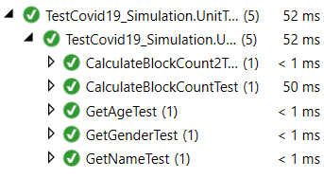
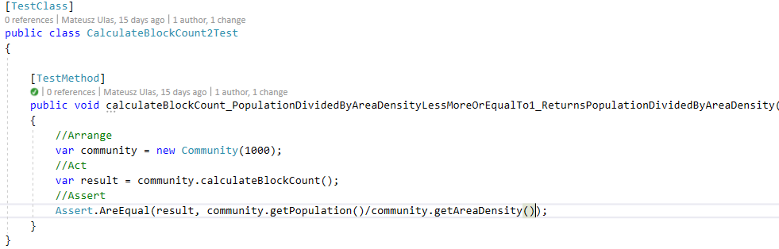
Unit testing
Notes:
We also have several unit tests, you can find the full description of them in the Design Document. We prepared them in a Arrange - Act - Assert way.

Slide 18
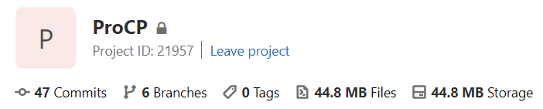
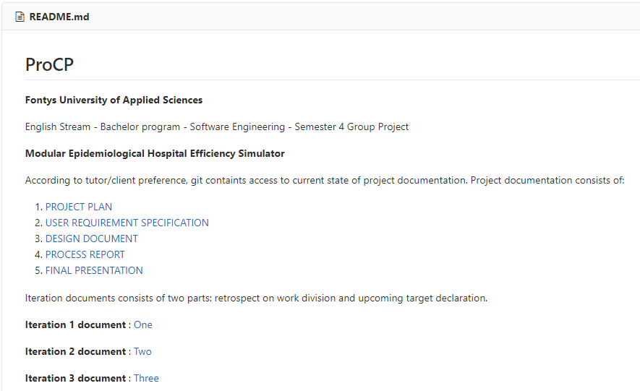

Slide 19
References
Chung, K. et al. - A simulation application workbook. Project core phase. February 2020, Fontys. At: https://portal.fhict.nl/es/PROCSHARP/ProCP_Workbook [Feb2020].pdf
Adhanom, T. G. - World Health Organization director tweet. At: https://twitter.com/DrTedros/status/1226629008302931971
Article - Field hospital. Wikipedia. At: en.wikipedia.org/wiki/Field_hospital
Weather Information for Wuhan. At: https://en.climate-data.org/asia/china/hubei/wuhan-2629/
Yoshiaki, N. - Two Japan Evacuess Get Coronavirus After First Testing Negative. At: https://www.bloomberg.com/news/articles/2020-02-11/two-japan-evacuees-getcoronavirus-after-first-testing-negative
Collaborative article - Clinical characteristics of 2019 novel coronavirus infection in China. Medical article. At: https://doi.org/10.1101/2020.02.06.20020974
The Dutch measures against coronavirus. Government guidelines. At: https://www.government.nl/topics/coronavirus-covid-19/tackling-new-coronavirus-in-the-netherlands
Coronavirus - The hospital built in a matter of days. News Article 2020. At: https://www.bbc.com/news/in-pictures-51280586
Coronavirus - Flatten the curve explanation. Science Article 2020. At: https://www.livescience.com/coronavirus-flatten-the-curve.html
Dave Babbitt, D. , Garland, P., Johnson, O. (2020). Lived population density and the spread of COVID-19 Retrieved May 10, 2020, from https://arxiv.org/pdf/2005.01167.pdf
Morris, C., Reuben, A. (2020). Coronavirus: Why are international comparisons difficult? 19 Retrieved May 20, 2020, from https://www.bbc.com/news/52311014
Children's Hospital of Philadelphia, PolicyLab.(2020) Forecasting the Impacts of Weather and Social Distancing on COVID-19 Transmission Across the U.S. Retrieved May 10, 2020, from https://policylab.chop.edu/project/forecasting-impacts-weather-and-social-distancing-covid-19-transmission-across-us
D’souza,G., Dowdy,D. (2020) What is Herd Immunity and How Can We Achieve It With COVID-19?
Retrieved May 10, 2020, from https://www.jhsph.edu/covid-19/articles/achieving-herd-immunity-with-covid19.html
Galladaro, C. (2020) Lockdown rules baffle Europeans Retrieved May 10, 2020, from https://www.politico.eu/article/lockdown-rules-leave-europeans-baffled-and-fined-coronavirus-covid19/

Slide 20
DEMO TIME

